Slide 1

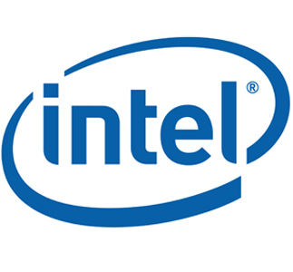


DigiToys

Slide 2
DigiToys
Physical
Toys +
Digital
Animation
A new technology platform for story and play built on top of traditional toys.

Slide 3
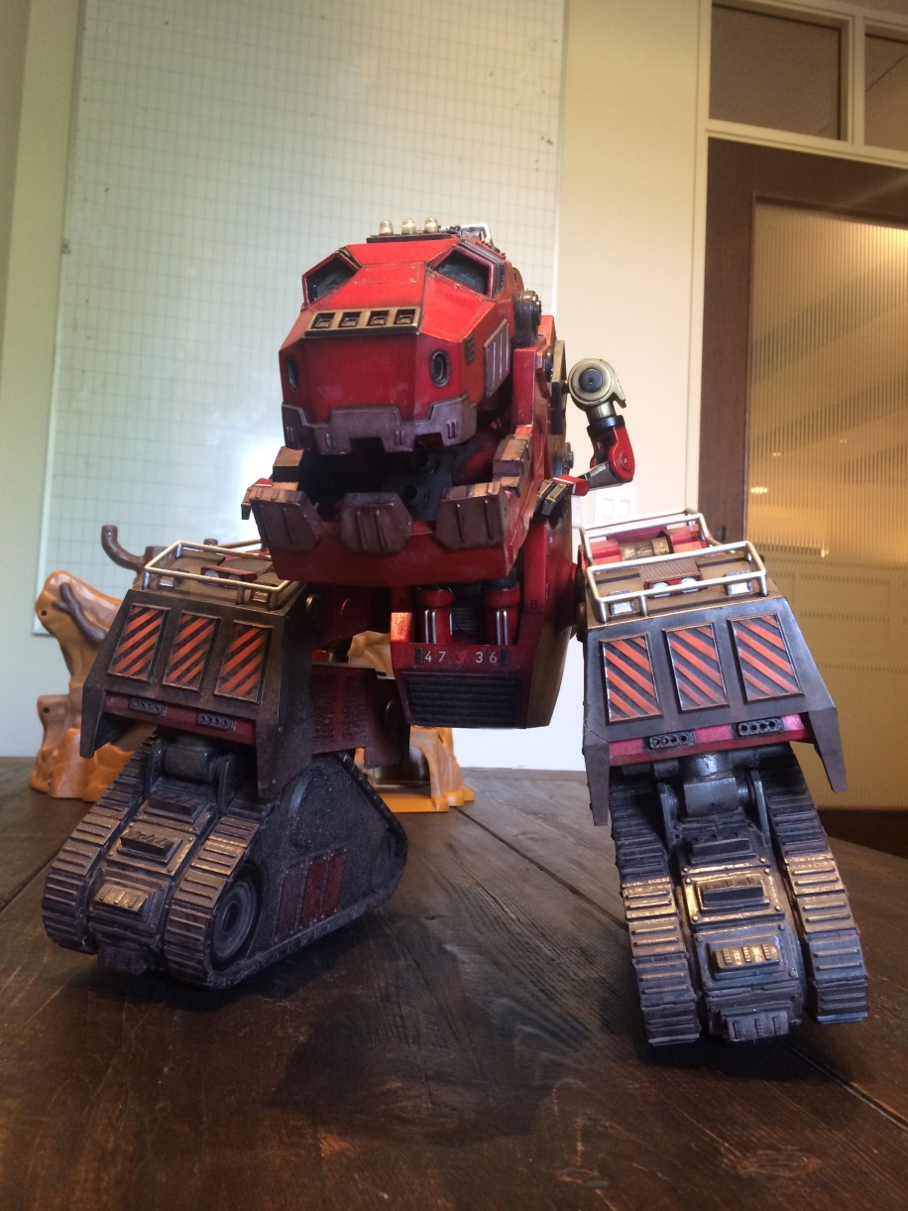
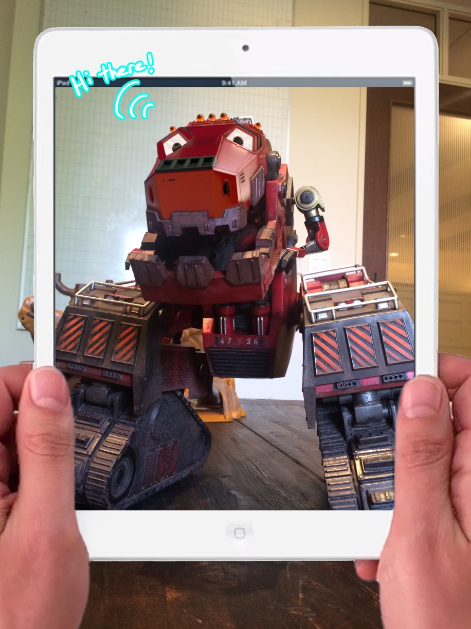
BRING YOUR TOYS TO LIFE

Slide 4
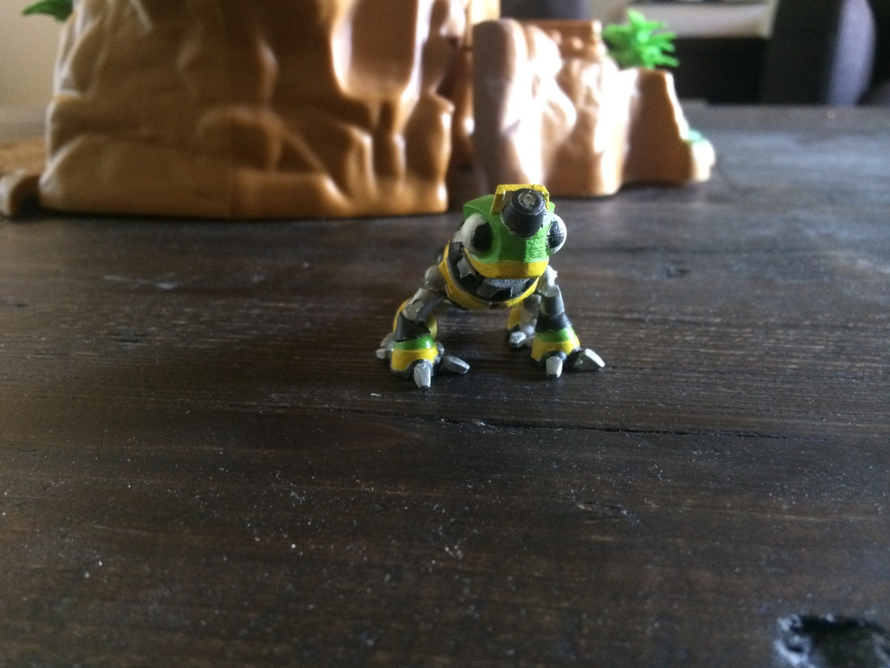
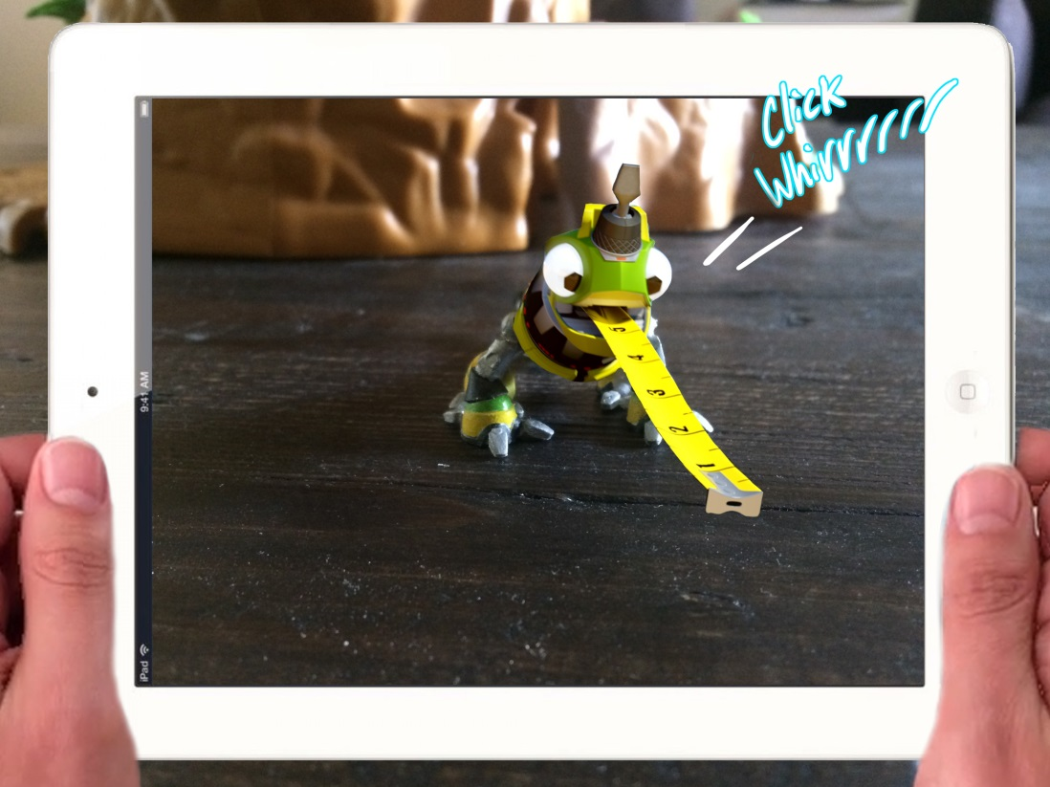
BRING YOUR TOYS TO LIFE

Slide 5
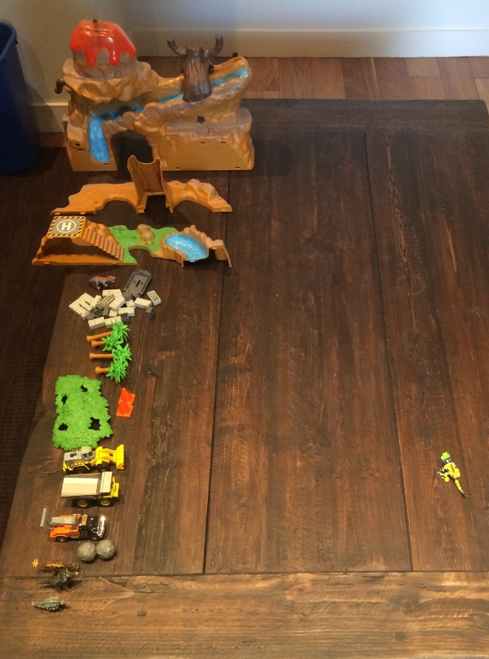
Learn from the digital characters as they help you build their world with your real toys.

Slide 6
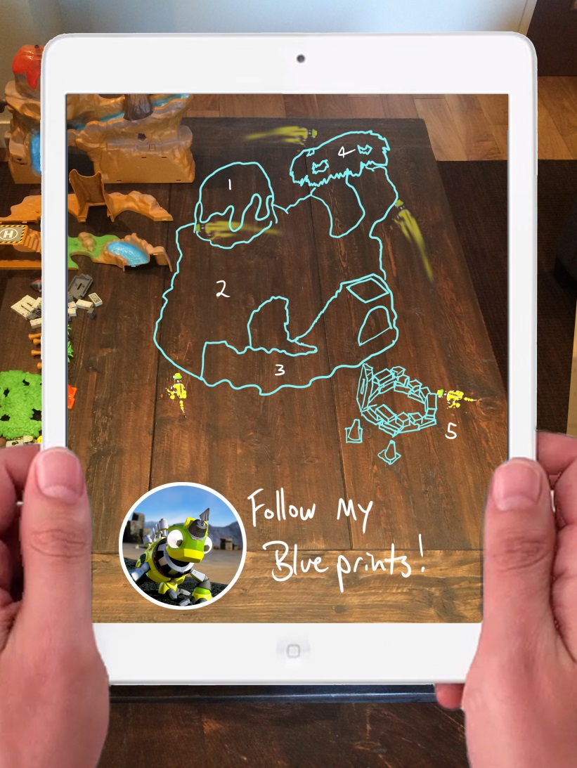
Learn from the digital characters as they help you build their world with your real toys.

Slide 7
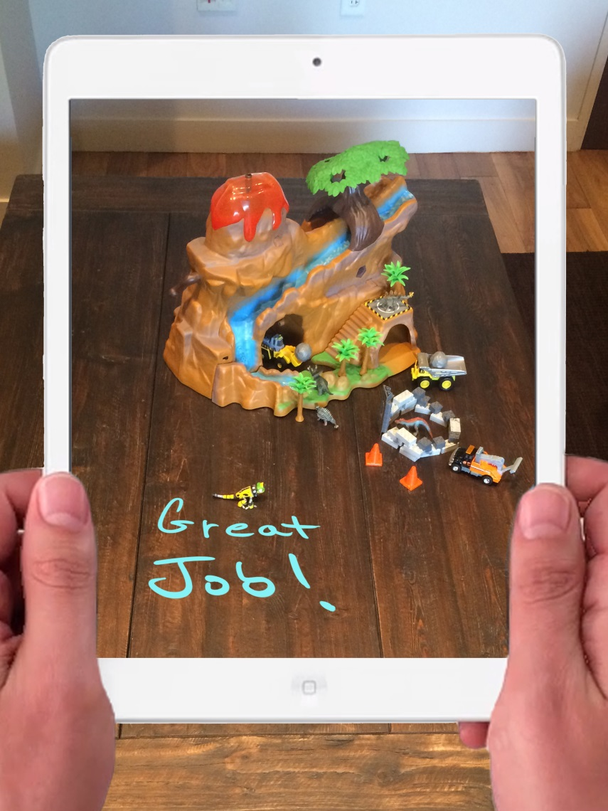
Learn from the digital characters as they help you build their world with your real toys.

Slide 8
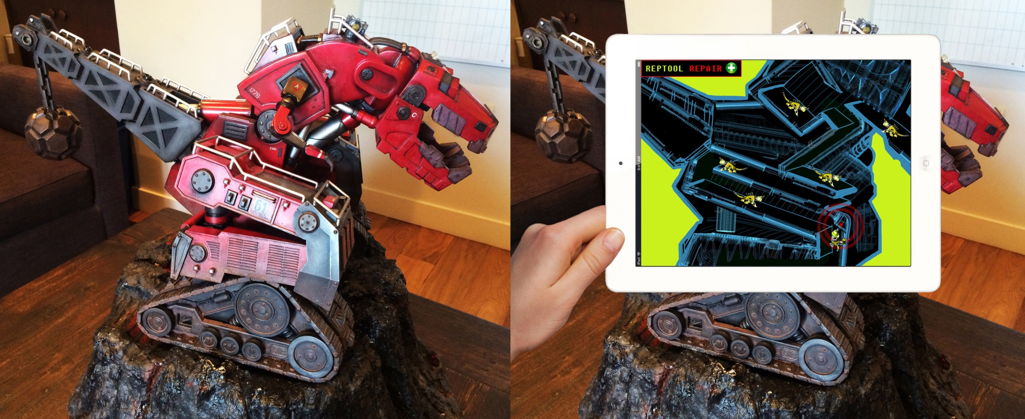

Slide 10
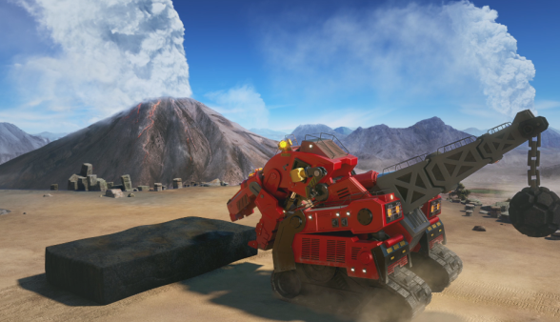
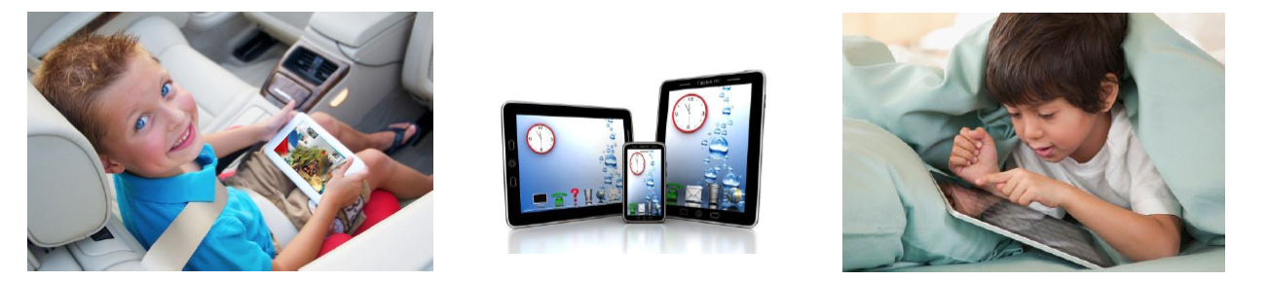
WHEN PLAYTIME IS OVER, SET TO ‘AUTO-PLAY’
LEAVE YOUR CHARACTERS TO BUILD ON THEIR OWN!
Monitor your STORY-ECOSYSTEM remotely like a construction site live-feed
360/365 ENGAGEMENT

Slide 11
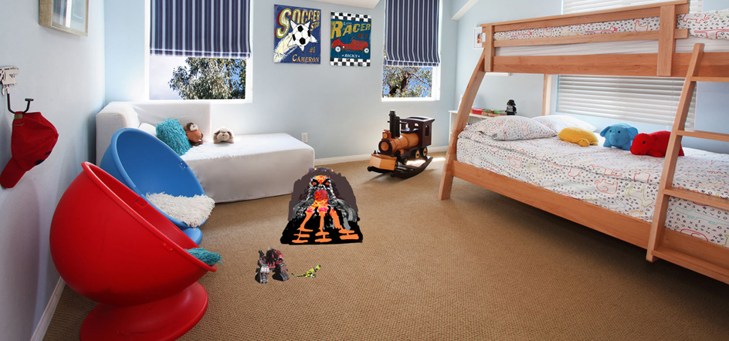
THESE ARE TOYS…

Slide 12
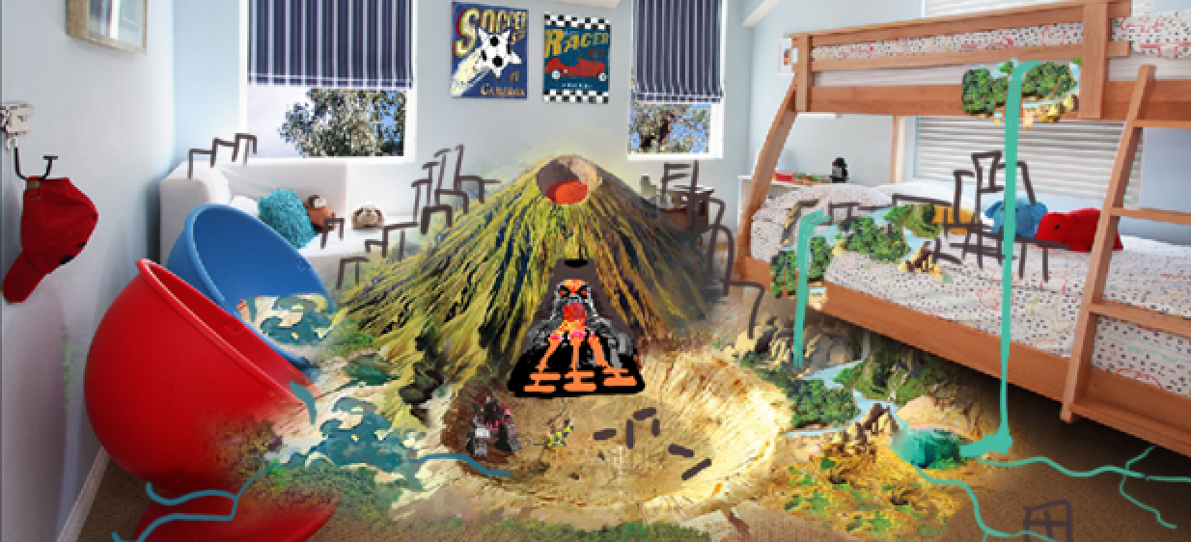
...THAT CREATE WORLDS

Slide 13
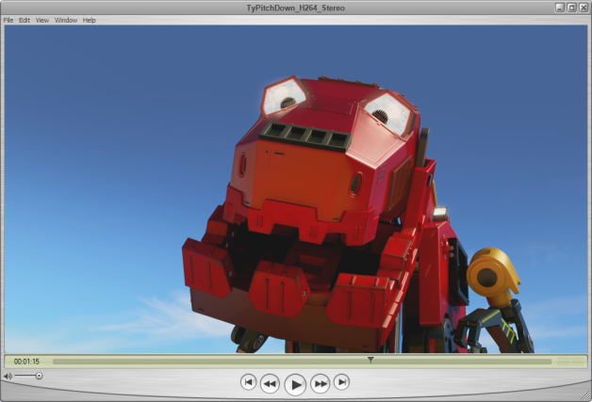
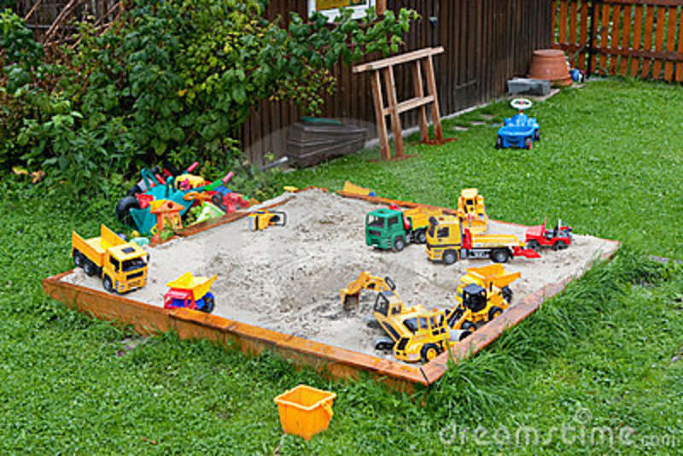
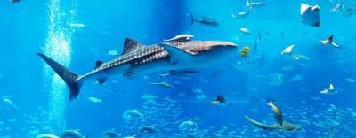
FUSION OF
DWA CHARACTERS & STORYTELLING
UNSTRUCTURED FREEDOM OF
SANDBOX PLAY
EXCITING AND UNPREDICTABLE
ECOSYSTEM

Slide 14
RealSense and Dinotrux
"DreamWorks plans for the Dinotrux franchise to exist and evolve for many years. A combination of TV show, physical toys, and mixed-reality software experience are all tied together by Intel's RealSense platform. RealSense makes it possible to combine traditional video, physical toys, and a mixed-reality toy-play experience that's unlike anything else on the market. The Intel / DreamWorks partnership makes possible this long-term evolution, both of the user experience, and of the DinoTrux property itself."
Ian Richter Franchise Executive Producer for Dinotrux

Slide 15
RealSense Scene Perception
"The game-play experience for our Dinotrux franchise involves mixed-reality: we need to make it possible for a kid to bring his Dinotrux characters to life, right in his own room. RealSense's ability to scan a room, and to robustly localize room geometry, makes it possible for us to bring the world of the Dinotrux to life into the kid's room. Intel's RealSense technology is central to us being able to do this."
Vishwa Ranjan Digitoys Engineering Lead

Slide 16
RealSense Object Recognition
"Intel's RealSense is critical to us being able to realize the vision we have for Dinotrux... we're defining a new category of play, one that avoids the "zombie stare" associated with video games and that also allows parents and kids to both enjoy the game-play experience. Central to this game-play is the ability to take a physical Dinotrux toy and to "scan it in" to the digital experience. Our AI system will then bring each character to life in the kid's room. The foundation of this is the RealSense-provided ability to robustly deliver Object Recognition... in a wide variety of lighting and viewing conditions, to tell the DreamWorks application that the kid owns a specific toy. Our vision for Dinotrux is not realizable without RealSense-provided Object Recognition."
Mark Drummond Digitoys Behavior System Lead

